Slide 1
Lecture 1
IoT Architecture Lab

Slide 2
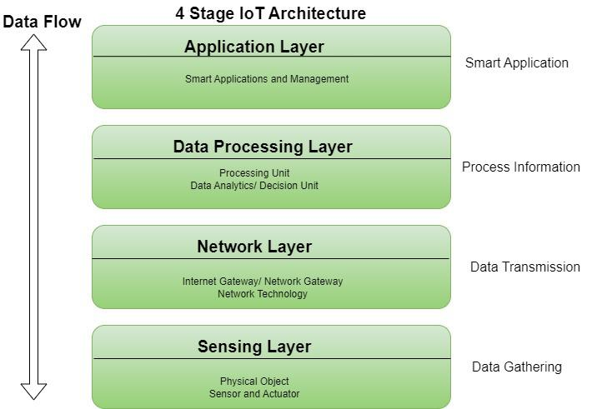
IoT Architecture

Slide 3
Overview of IoT Architecture
Sensors/Devices: Collection of data from the environment (e.g., temperature sensors, motion detectors, cameras).
Connectivity: Methods for devices to communicate (e.g., Wi-Fi, Bluetooth, Zigbee, LoRaWAN).
Edge Computing: Local processing at the edge devices to reduce latency and bandwidth usage.
Cloud Computing: Centralized data storage, processing, and analysis.
Data Analytics: Tools for analyzing the data collected to derive insights.
User Interface: Dashboard or app for monitoring and interacting with the IoT devices.

Slide 4
Lab Components
Hardware: Sensors, actuators, microcontrollers (like Arduino, Raspberry Pi), gateways, etc.
Software: Firmware for devices, middleware for data processing, and cloud platforms (like AWS IoT, Azure IoT).
Connectivity Protocols: Testing different protocols like MQTT, CoAP, HTTP/HTTPS, etc.
Security: Implementing and testing encryption, authentication, and other security measures.
Simulation Tools: Tools to simulate IoT environments (e.g., Cisco Packet Tracer, Cooja).

Slide 5
Lab Exercises
Device Integration: Setting up and integrating different IoT devices.
Data Collection and Processing: Capturing data from sensors, processing it at the edge, and sending it to the cloud.
Real-time Monitoring: Setting up dashboards to monitor data in real-time.
Automation and Control: Implementing automation scenarios where data triggers specific actions (e.g., turning on lights when motion is detected).
Security Implementation: Encrypting communication, implementing secure boot, and setting up secure device management.
Performance Testing: Evaluating the performance of the IoT system under different loads.

Slide 6
Tools and Platforms
Development Kits: ESP32, Raspberry Pi, Arduino.
Cloud Platforms: AWS IoT Core, Google Cloud IoT, Azure IoT Hub.
Data Analytics Tools: MATLAB, Python libraries (Pandas, NumPy), IoT analytics platforms.
Simulation and Visualization: MATLAB Simulink, Node-RED, Grafana for dashboards.

Slide 7
Modern Application of IoT
Smart Grids and energy saving
Smart cities
Smart homes/Home automation
Healthcare
Earthquake detection
Radiation detection/hazardous gas detection
Smartphone detection
Water flow monitoring
Traffic monitoring
Smart door lock protection system
Robots and Drones
Healthcare and Hospitals, Telemedicine applications
Biochip Transponders (For animals in farms)
Heart monitoring implants (Example Pacemaker, ECG real time tracking)

Slide 8
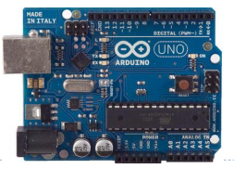
What is Arduino?
An Arduino board consists of an Atmel 8-bit AVR microcontroller with complementary components that facilitate programming and incorporation into other circuits.
It's an open-source physical computing platform based on a simple microcontroller board, and a development environment for writing software for the board

Slide 9
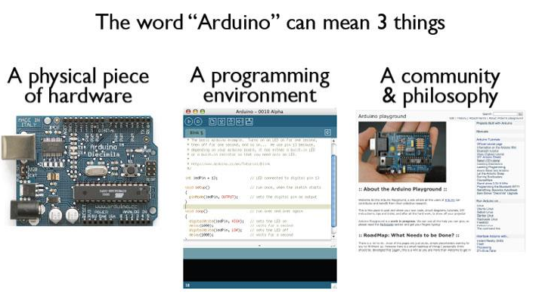
What is Arduino?

Slide 10
Why Arduino
Open source and extensible software- The Arduino software is published as open source tools, available for extension by experienced programmers. The language can be expanded through C++ libraries
Open source and extensible hardware -The Arduino is based on Atmel's ATMEGA8 and ATMEGA168 microcontrollers. The plans for the modules are published under a Creative Commons license, so experienced circuit designers can make their own version of the module, extending it and improving it.
Inexpensive
Cross-platform
Simple, clear programming environment

Slide 11
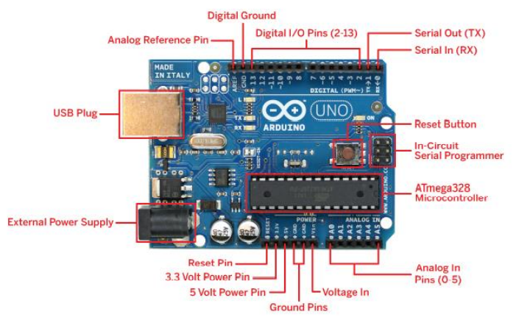
Arduino UNO board

Slide 12
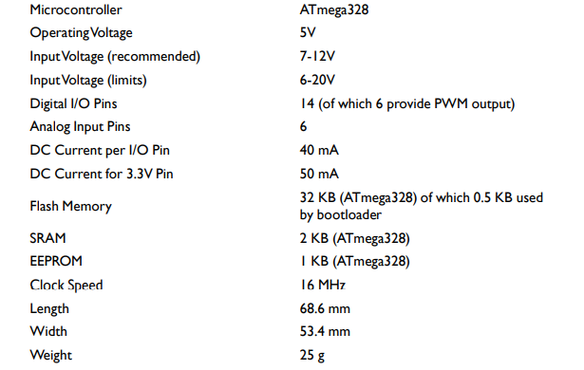
UNO Spec

Slide 13
Arduino has
Flash memory: it's a rewritable non-volatile memory. This means that its content will still be there if you turn off the power. It's a bit like the hard disk on the Arduino board. Your program is stored here. code for writing and retrieving any data structure to EEPROM easily.
RAM: it's like the RAM in your computer. Its content disappears when you turn off the power, but it can be read and written really fast. Every normal variable in your sketch is held in RAM while your sketch runs.
EEPROM: it's an older technology to implement rewritable non-volatile memory. It's normally used to store settings and other parameters between resets.

Slide 14
Power
The Arduino Uno can be powered via the USB connection or with an external power supply. The power source is selected automatically.
External (non-USB) power can come either from an AC-toDC adapter (wall-wart) or battery. The adapter can be connected by plugging a 2.1mm center-positive plug into the board's power jack. Leads from a battery can be inserted in the Gnd and Vin pin headers of the POWER connector.
The board can operate on an external supply of 6 to 20 volts. If supplied with less than 7V, however, the 5V pin may supply less than five volts and the board may be unstable. If using more than 12V, the voltage regulator may overheat and damage the board. The recommended range is 7 to 12 volts

Slide 15
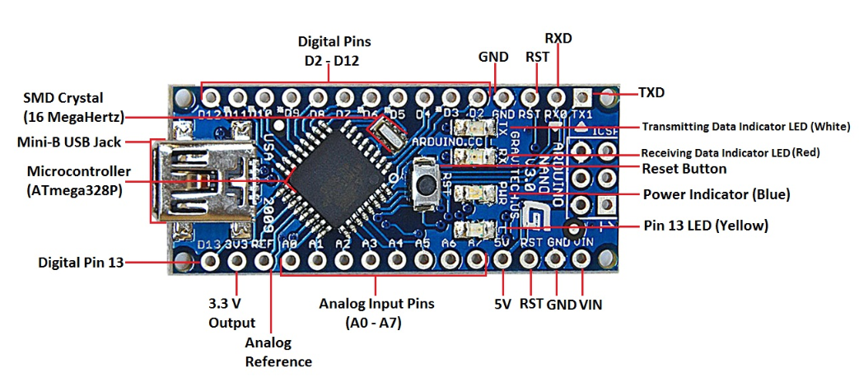
Arduino Nano V3.0

Slide 16
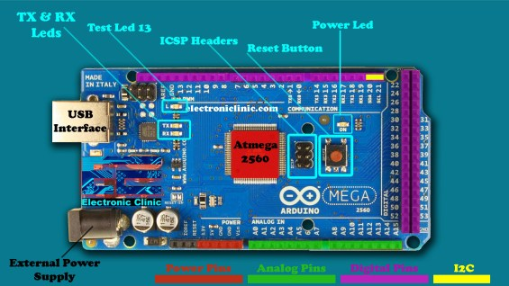
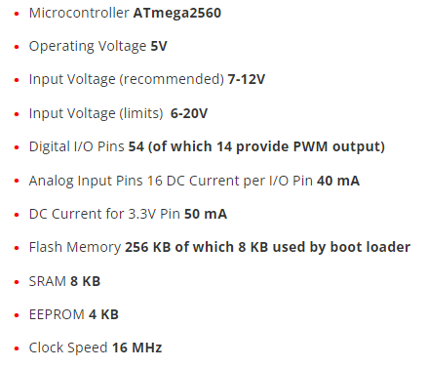
Arduino Mega

Slide 17
Getting Started !
Visit: http://arduino.cc/en/Main/Software
Download & install the Arduino environment (IDE) for Windows, Mac, or Linux. (Latest version: 1.6)
Launch the Arduino IDE
Select your board (Tools>>board>>UNO)
Select Port No

Slide 18
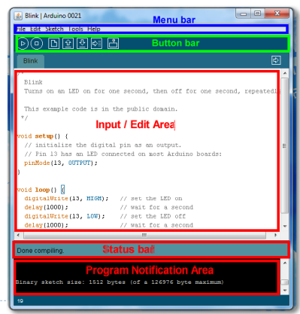
Arduino IDE

Slide 19
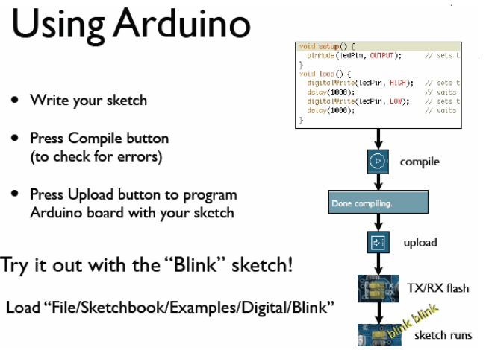

Slide 20
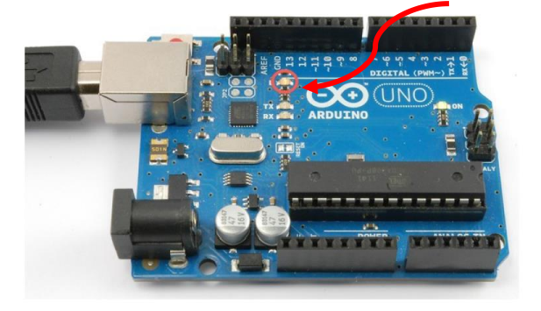
Our First Program ! Blink
Now, you will learn how to make the built-in LED blink

Slide 21
Our First Program ! Blink
You might notice that your Arduino board's built-in LED already blinks when you connect it to a USB.
This is because Arduino boards are generally shipped with the 'Blink' sketch preinstalled.
We will do a simple variation to the program by changing the rate of the blink

Slide 22
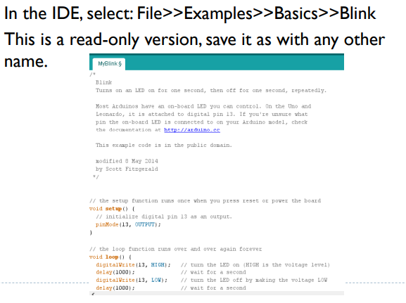
Our First Program ! Blink

Slide 23
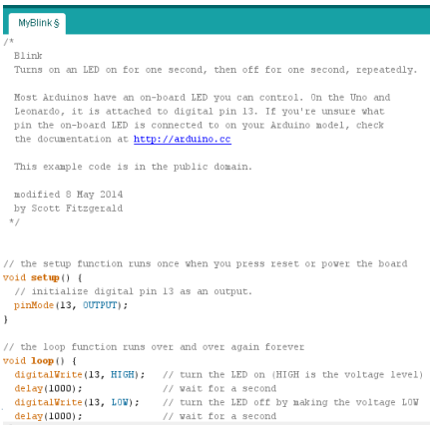
Understand the code

Slide 24
Run the code
Make sure that Arduino is connected to your PC.
Click Upload and wait until the status is done.

Slide 25
Ex1-Blink using External LED
Connect a LED to any digital pin on your Arduino, and put a resistance (270 ohm) in series to limit the current passing through the LED.
Make the necessary code changes.
Change the resistance value: 470 ohm, 1K, 10K, What is your observation?
Observation: The LED illumination decreases as larger resistance is used.

Slide 26
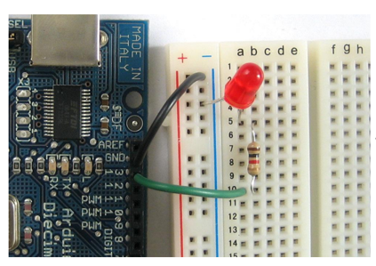
Ex1-Blink using External LED

Slide 27
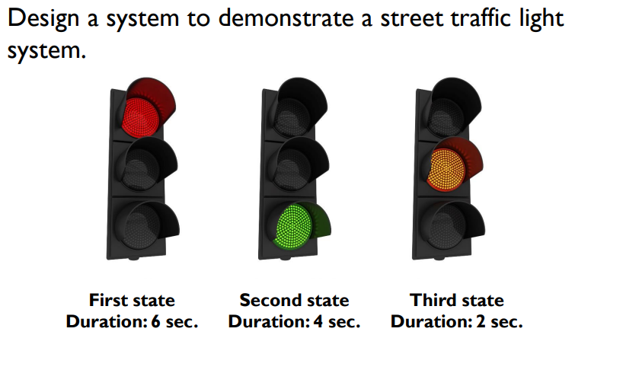
Ex2-LEDs Traffic

Slide 28
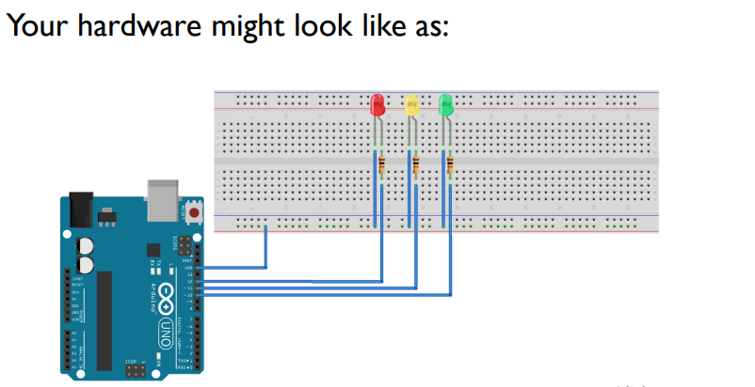
Ex2-LEDs Traffic

Slide 29
Thank You

